Slide 1
Peace by Piece
Project Showcase 1

Slide 2

What is PbP again?
Chess-like strategy game
Gain points by capturing pieces
Buy pieces with the points

Slide 3
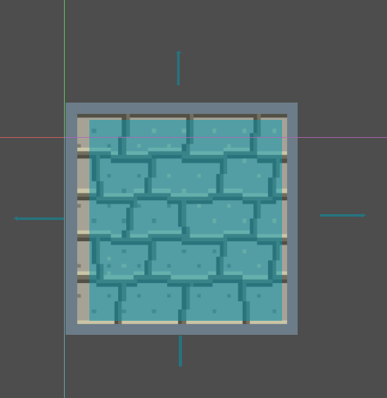
What have we done?
We started out with the board design

Slide 4
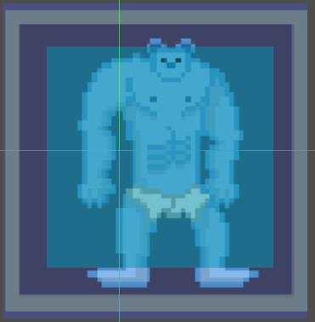
Then we started work on the basic piece movement

Slide 5
Demonstration

Slide 6
What are we planning?
This month
Finish “special” piece movement
Get the team system up
Get the points system up
Create the system to buy pieces
Input win conditions
Implement check system
This should conclude the “Core Mechanics”

